Slide 1
CLOPS: CONTINUAL LEARNING OF PHYSIOLOGICAL SIGNALS
魏煜华
2021.1.8

Slide 2
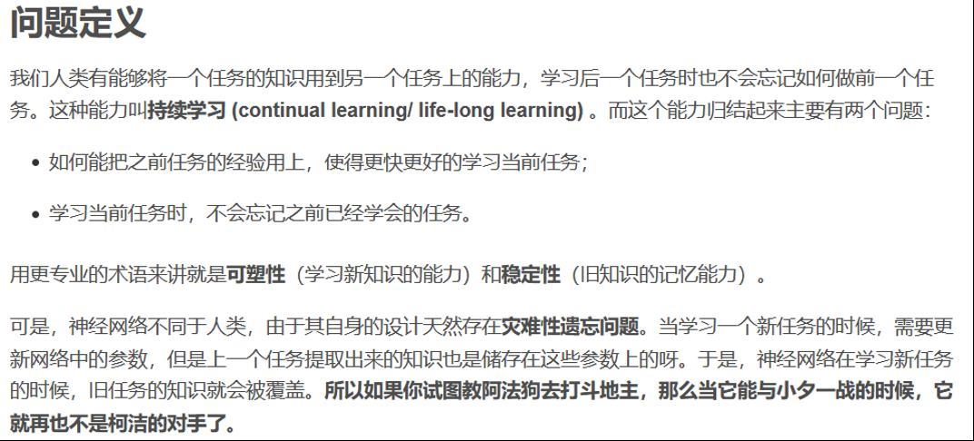
Continual learning/ Life-long learning

Slide 3
Introduction
Many deep learning algorithms operate under the assumption that instances are independent and identically-distributed (i.i.d.).
The assumption of independence can be violated, for example, when data are streamed temporally from a sensor.
This is particularly true in healthcare where the multitude of physiological sensors generate time-series recordings that may vary temporally (due to seasonal diseases; e.g. flu), across patients (due to different hospitals or hospital settings), and in their modality.
To the best of our knowledge, we are the first to explore and propose a CL approach in the context of physiological signals.
Notes:
1. 许多深度学习算法在假设实例是独立的和同分布的(i.i.d)下运行。
2. 独立的假设可能会被违背，例如，当数据暂时地从一个传感器流。
3. 在医疗保健领域尤其如此，大量的生理传感器产生的时间序列记录可能会随时间而变化(由于季节性疾病;(由于不同医院或医院设置)以及他们的就诊方式。
4. 我们是第一个在生理信号的背景下探索和应用CL方法的。

Slide 4
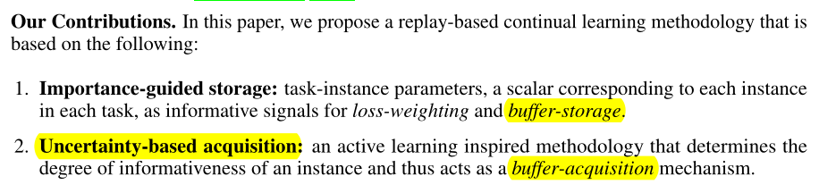
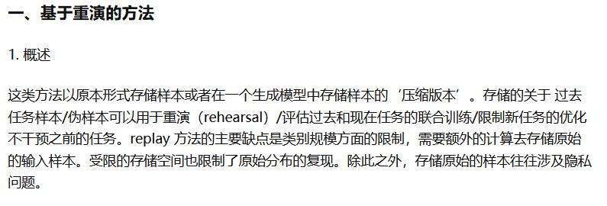
Introduction
Contributions
Notes:
贡献：在本文中，我们提出了一种基于重播的持续学习方法，该方法基于以下内容:
Importance-guided storage： 任务实例参数，是一个对应于每个任务中每个实例的标量，作为损失加权和缓冲存储的informative 信号。
基于不确定性的获取: 一种主动学习启发的方法，它决定了一个instance的信息量，因此充当了一种缓冲获取机制。

Slide 5
Related Work
Continual learning (CL)
Those similar to ours comprise memory-based methods such as iCaRL (Rebuffi et al., 2017), CLEAR (Rolnick et al., 2019), GEM (Lopez-Paz & Ranzato, 2017), and aGEM (Chaudhry et al., 2018).
The latter two methods naively populate their replay buffer with the last m examples.
In contrast to previous research that independently investigates buffer-storage and acquisition strategies, we focus on a dual storage and acquisition strategy.
Active learning (AL) in healthcare
Gal et al. (2017) adopt BALD (Houlsby et al., 2011) with Monte Carlo Dropout to acquire instances that maximize the Jensen-Shannon divergence (JSD) across MC samples.
To the best of our knowledge, we are the first to employ AL-inspired acquisition functions in the context of CL.
Notes:
CL：
1. 与我们类似的包括基于内存的方法，如iccarl 、CLEAR 、GEM 和aGEM 。
2. 后两个方法用最后的m个instance简单地放到replay buffer 。
3. 与以往独立研究缓冲存储和获取策略的研究不同，我们侧重于双存储和获取策略

Slide 6
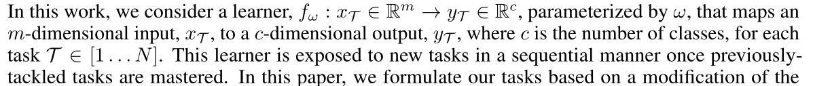
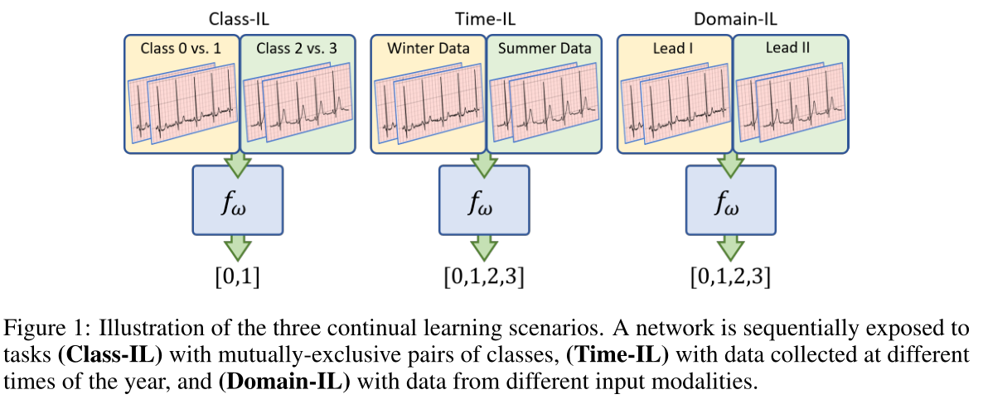
Continual learning
问题定义
Class Incremental Learning (Class-IL)
a network is sequentially tasked with solving a binary classification
problem in response to data from mutually-exclusive pairs of classes
Time Incremental Learning (Time-IL)
multiclass classification problem in response to data collected at different
times of the year (e.g., winter and summer)
Domain Incremental Learning (Domain-IL)
a multi-class classification problem in response to inputs with a different
Modality (lead)
Notes:
(类增量学习): 网络顺序地解决二分类问题任务，以响应来自互斥类对的数据
(时间增量学习): 多类分类问题，以响应在一年的不同时间(例如，冬天和夏天)收集的数据
(域增量学习): 多类分类问题，以响应具有不同模态的输入

Slide 7
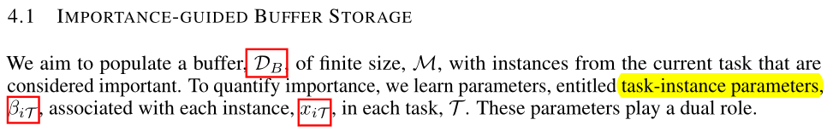
METHODS
The two ideas underlying our proposal are
the storage of instances into
the acquisition of instances from a buffer

Slide 8
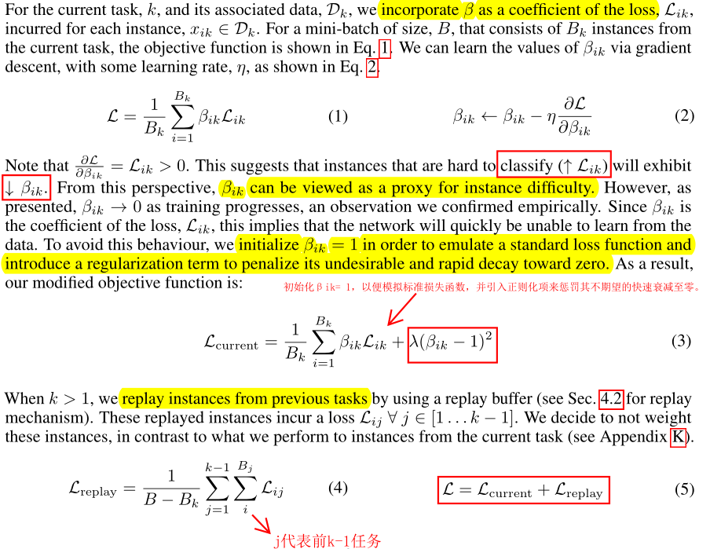
LOSS-WEIGHTING MECHANISM

Slide 9
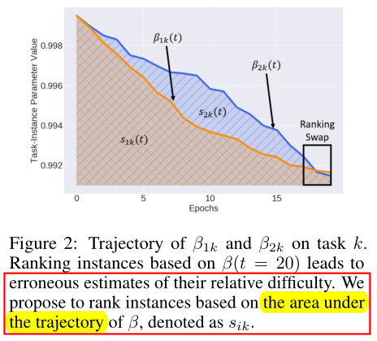

BUFFER-STORAGE MECHANISM
We leverage β, as a proxy for instance difficulty, to store instances into the buffer.
In selecting instances for storage into the buffer, we can:
1) retrieve their corresponding β values at the conclusion of the task, i.e., at β(t = 20),
2) rank all instances based on these β values
3) acquire the top b fraction
The higher the value of the storage fraction, b, the more likely it is that the buffer will contain representative instances and thus mitigate forgetting.

Slide 10
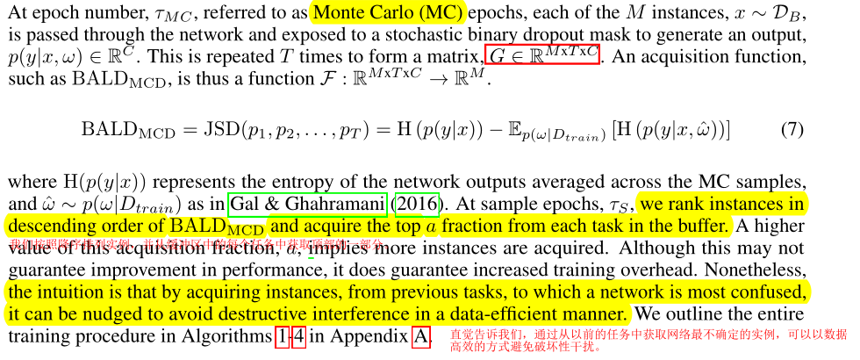
UNCERTAINTY-BASED BUFFER ACQUISITION

Slide 11
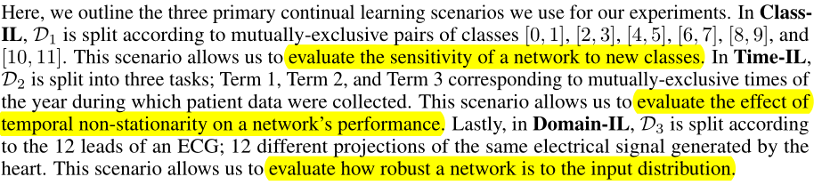
EXPERIMENTAL DESIGN
DATASETS
CONTINUAL LEARNING SCENARIOS
BASELINE METHODS
Multi-Task Learning (MTL)
Fine-tuning
GEM
MIR

Slide 12
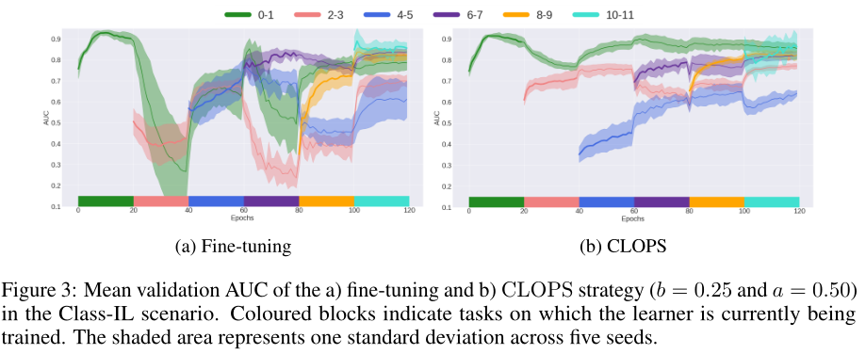
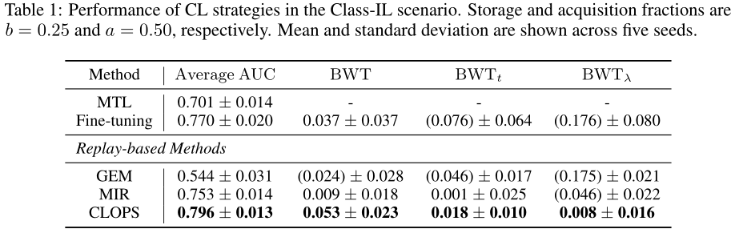
EXPERIMENTAL RESULTS
CLASS-IL

Slide 13
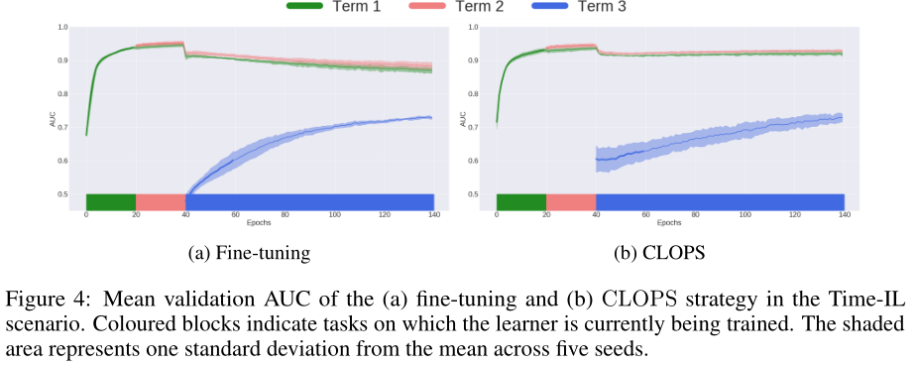
EXPERIMENTAL RESULTS
TIME-IL
Environmental changes within healthcare can introduce seasonal shift into datasets.
CLOPS is capable of achieving forward weight transfer (FWT).
By placing greater emphasis on more useful instances, the generalization performance of the network is improved.
CLOPS exhibits reduced catastrophic forgetting relative to fine-tuning.

Slide 14
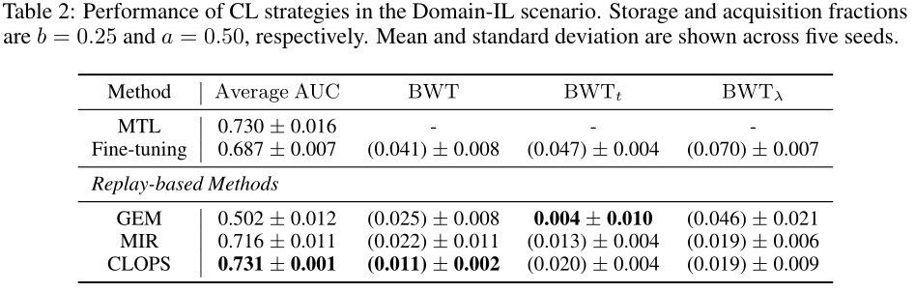
EXPERIMENTAL RESULTS
DOMAIN-IL
In Table 2, we illustrate the performance of the CL strategies in the Domain-IL scenario.
CLOPS outperforms state-of-the-art methods.

Slide 15
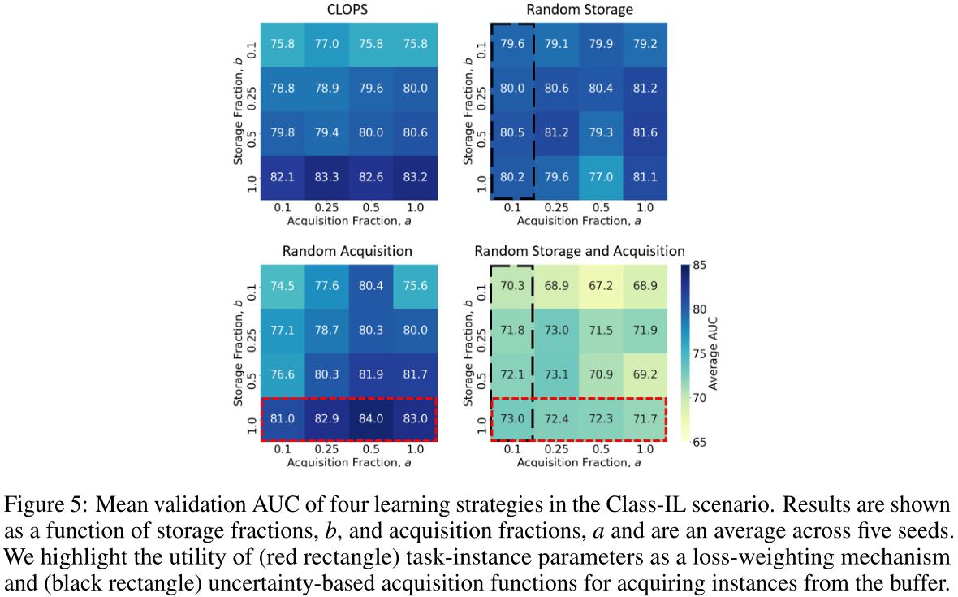
EFFECT OF TASK-INSTANCE PARAMETERS, β, AND ACQUISITION FUNCTION, α
Three ablation studies:
Random Storage dispenses with task-instance parameters and instead randomly stores instances into the buffer
Random Acquisition dispenses with acquisition functions and instead randomly acquires instances from the buffer
Random Storage and Acquisition which stores instances into, and acquires instances from, the buffer randomly.
We find that β, as a loss-weighting mechanism, benefits generalization performance.
For example, in Fig. 5 (red rectangle), at b = 1, a = 0.5, we show that simply including the loss-weighting mechanism ↑ AUC ≈ 12%.
uncertainty-based acquisition functions offer significant improvements

Slide 16
DISCUSSION AND FUTURE WORK
A replay-based method applied to physiological signals, entitled CLOPS.
CLOPS consists of an importance-guided buffer-storage and active-learning inspired buffer-acquisition mechanism.
CLOPS outperforms the state-of-the-art methods, GEM and MIR.
FUTURE WORK
Extensions to Task Similarity
Predicting Destructive Interference

